Slide 1
Clustering Algorithms - II
BILD62/WI26
May 21, 2026
Aalok Varma, PhD
[pronounced ah-l-oak]
Postdoctoral Fellow, Loren Looger Lab,
Neuroscience Dept, UC San Diego

Slide 2
Lesson Objectives
Recap: k-means clustering
Enumerate examples of real-world applications of clustering
Load and explore experimental datasets
Recognize the need for data preprocessing and dimensionality reduction methods
Identify a common dimensionality reduction method, i.e., PCA
Apply k-means clustering to realistic data
Interpret results from clustering analysis

Slide 3
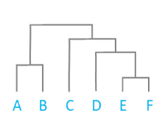
Recap: Two common methods of clustering
Hierarchical clustering
K-Means Clustering

Slide 4
Clustering is a basic method in machine learning
https://www.mathworks.com/discovery/machine-learning.html

Slide 5
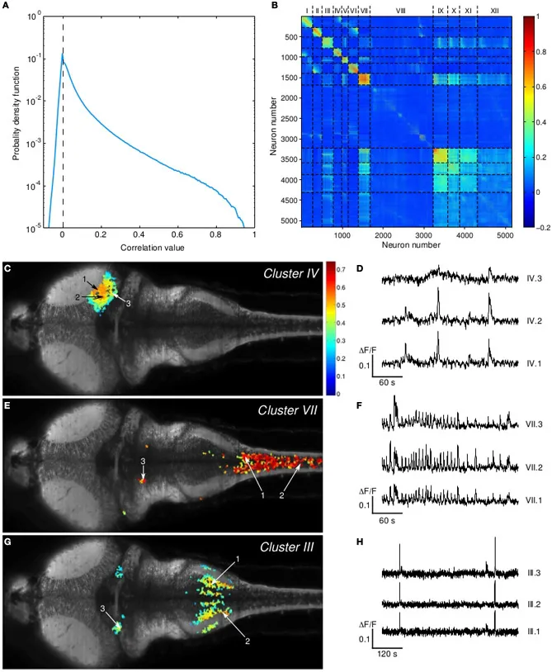
Real-world applications of clustering 1: Neuroscience
Hierarchical clustering of neural activity imaging data reveals groups of neurons/brain regions that are co-regulated
Panier et al. (2013)

Slide 6
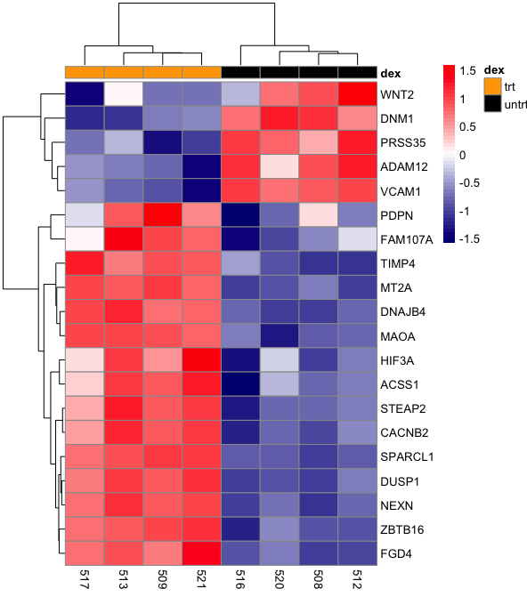
Real-world applications of clustering 2: RNAseq
Find groups of genes
that are co-regulated
https://bioinformatics.ccr.cancer.gov/docs/data-visualization-with-r/Lesson5_intro_to_ggplot/

Slide 7
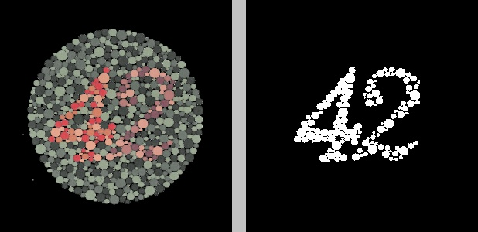
Real-world applications of clustering 3: Image Analysis
Original image
Segmented image
https://nrsyed.com/2018/03/29/image-segmentation-via-k-means-clustering-with-opencv-python/

Slide 8
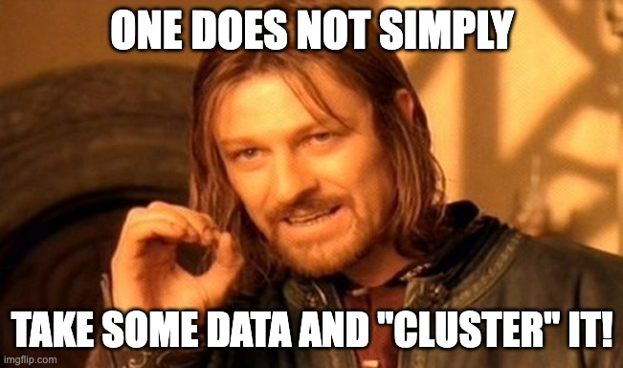

Slide 9
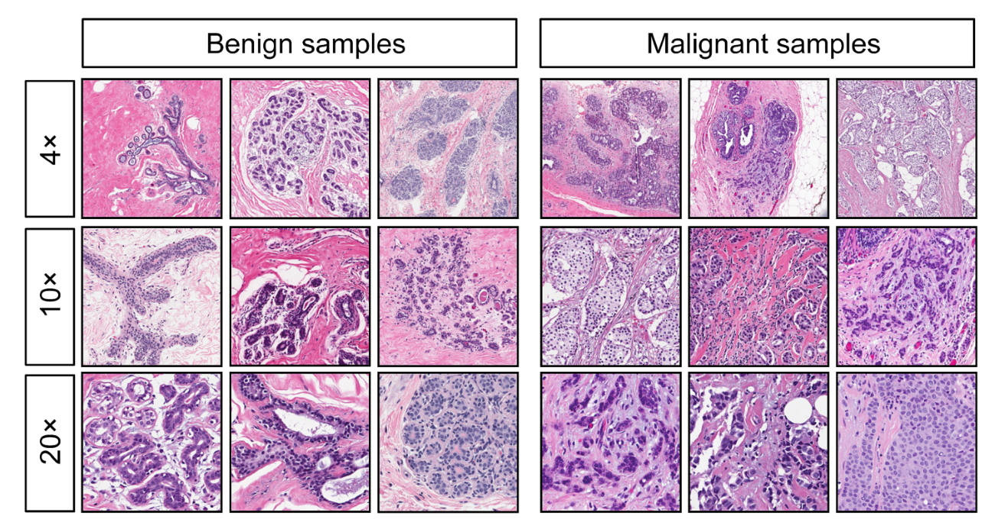
Step 0 – Know the data!!
Source: Wisconsin Breast Cancer Data
Fine needle aspirate (FNA) of a breast mass
Stain → Digitize nuclei of cells
Extracted nucleus parameters:
Radius
Perimeter
Area
Smoothness
Texture
…

Slide 10
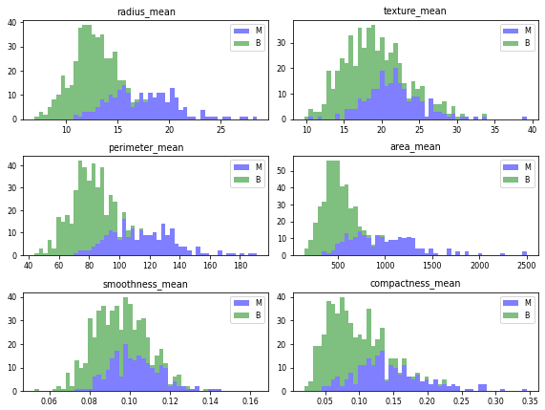
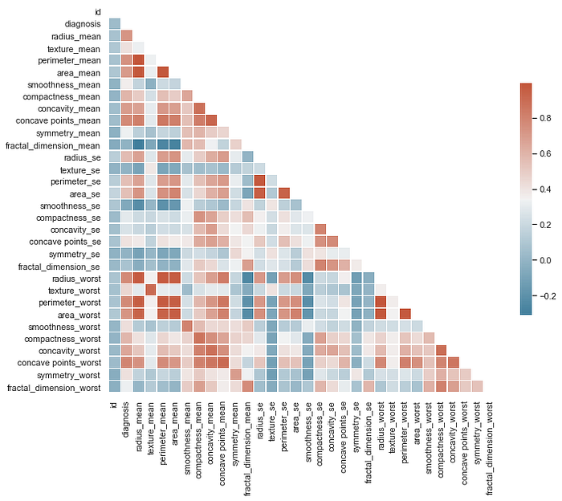
Step 1 – Explore and visualize the data
Histograms to look at distributions
Correlations between variables

Slide 11
Step 2 – Preprocess the data (if needed)
For today, I have run ”Principal Components Analysis” (PCA) on a subset of the data

Slide 12
What is PCA, and why do we need it?
PCA = Principal Components Analysis
Method of dimensionality reduction
Data in real life is multi-dimensional (3 or more independent variables)
Humans can’t visualize this large-scale data (we’re limited up to 3D)
Dimensionality reduction tries to compress n-dimensional data into 2D or 3D
As the name suggests, we’re trying to extract the main (“principal”) components of all the variation in the data

Slide 13
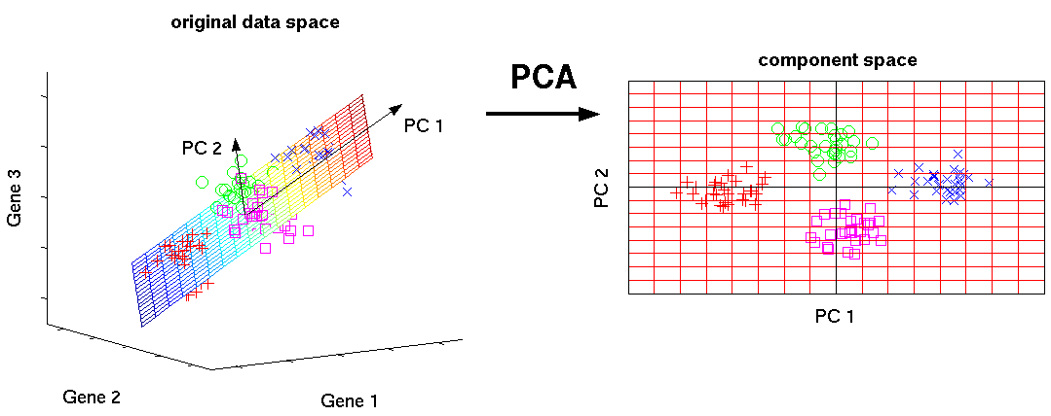
Visualizing what PCA does (intuition)

Slide 14
Step 3 – Cluster
Identify the method you’ll use
Choose your parameters
There are all things you get to decide, as a researcher

Slide 15
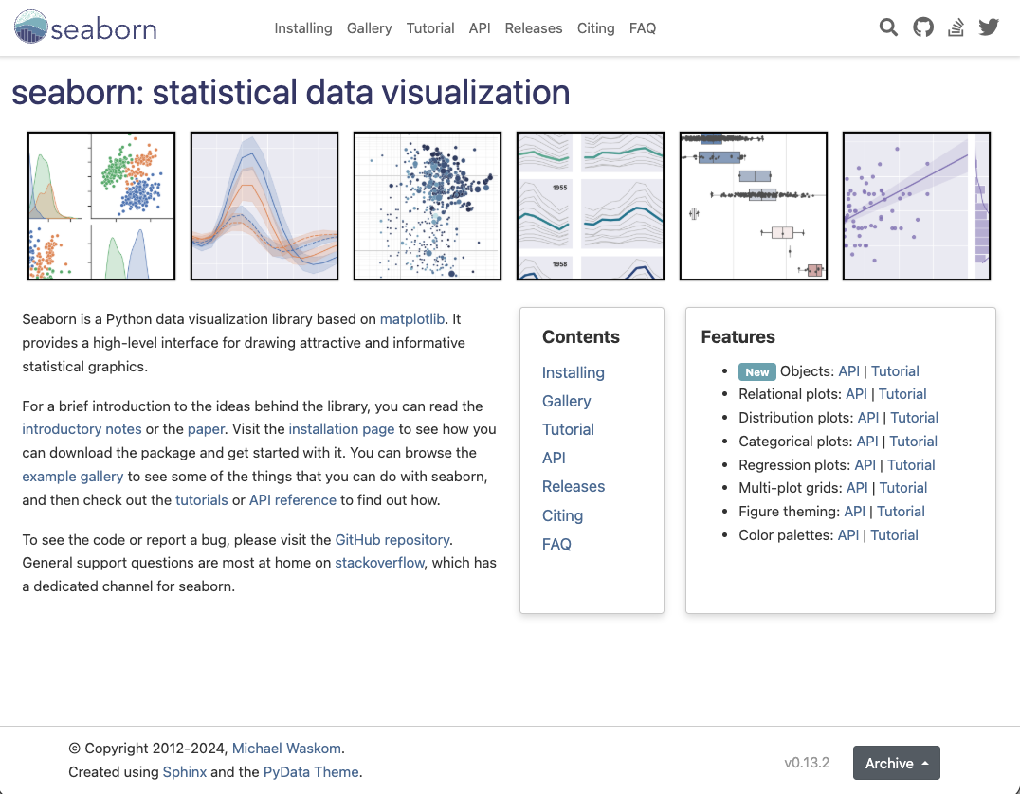
Brief intro to new plotting package - Seaborn

Slide 16
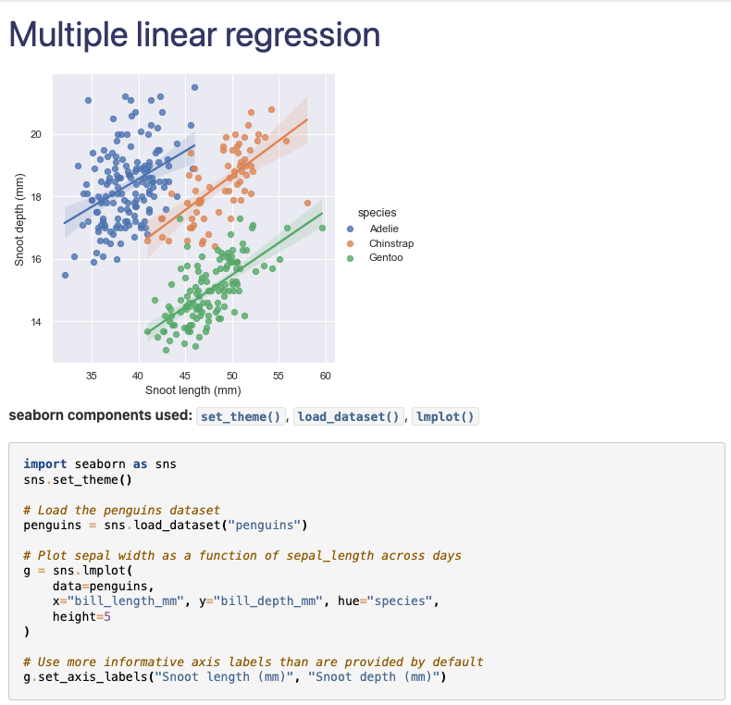
Brief intro to new plotting package - Seaborn

Slide 17
Hands on coding time!
Notebook 2

Slide 18
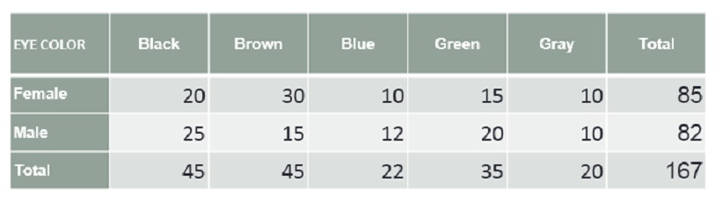
Contingency tables
Also called ‘cross-tabulation’
Special case: Confusion matrix

Slide 19
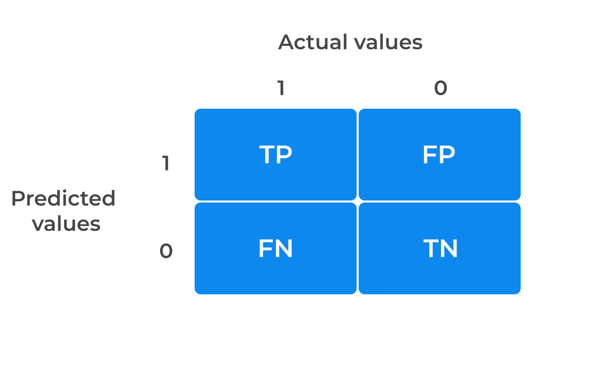
Special case: Confusion matrix

Slide 20
Some questions to ask yourself
How many clusters are in the data? How do I know?
Is there a biological significance for each of these clusters?

Slide 21
Summary of what we learned today
Clustering algorithms find many real-world applications
You don’t just take some data and simply “cluster” it
You need to:
Understand how the data were acquired
Explore the data – variables, data types, etc.
Visualize the data (if possible)
Pre-process the data
Only then are you ready to apply clustering algorithms
Always double- and triple-check that your results make sense

Slide 22
Some ideas for further exploration
Try out some different toy datasets
sklearn has many datasets by default: https://scikit-learn.org/stable/datasets.html
Explore some real datasets
Kaggle – Website with data science challenges
Ask me/other lab folks for some real data
Try other clustering algorithms

Slide 23
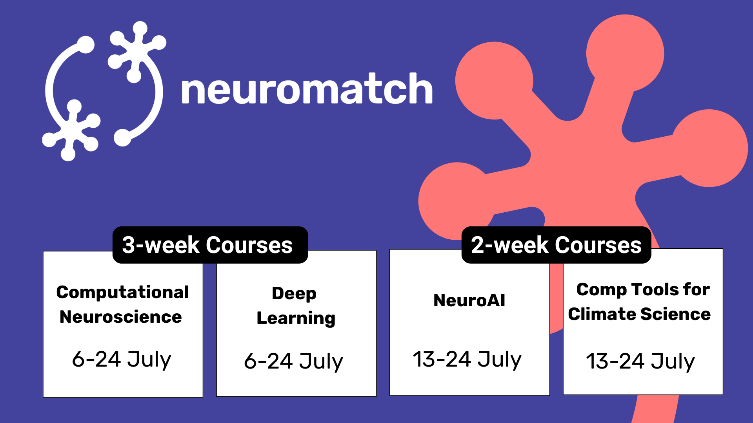
Neuromatch Academy courses
Apply by March 15, 2026

Slide 24
Extra resources
Introduction to Computation and Programming Using Python – John Guttag
https://ocw.mit.edu/courses/6-0002-introduction-to-computational-thinking-and-data-science-fall-2016/resources/lecture-12-clustering/
https://www.mathworks.com/discovery/clustering.html
https://www.huber.embl.de/msmb/05-chap.html#what-are-the-data-and-why-do-we-cluster-the
https://scikit-learn.org/stable/modules/clustering.html#k-means
https://scikit-learn.org/stable/modules/generated/sklearn.cluster.KMeans.html
https://scikit-learn.org/stable/auto_examples/cluster/plot_cluster_comparison.html
https://seaborn.pydata.org/tutorial/color_palettes.html

